Slide 1
Rotary Foundation & ICCs
Dana Moldovan
ICC National Coordinator USA
RC Thousand Oaks Sunrise
District 5240
Email: danamol@gmail.com

Slide 2
Matching Grants Program
MGs Program started in 1965
1965 – 2000 there were 10,000 approved MGs
2000 – 2004 – another 10,000 approved MGs
2004 – 2008 –another 10,000 approved MGs
Only 20% were large projects

Slide 3
Changes
Use our $$$ more efficiently - better ROI
Grater impact
Streamline operations
Better visibility
Analyze results and pass on the “knowhow”

Slide 4
Problems in the World
Too many people that live in Poverty
Too many Conflicts / Wars
Too many diseases
Too many children that are not going to school

Slide 5
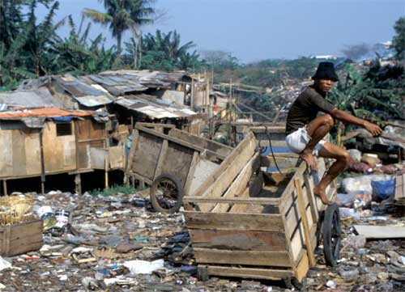
About 3 billion people
Live in Extreme Poverty!
They lack all the basics for survival!
Notes:
5

Slide 6
Problem Solving Approach
Let’s “fix it” !!!
Let’s start a project !

Slide 7
Development Projects
Projects that give “things”
Projects that Empower People

Slide 8
Projects that give “things”
Medical Missions-Rotoplast
Water filtration systems
Building houses
Mosquito Nets

Slide 9
Typical elements of a project that gives “things”
Involve Rotarians giving “things” to people
Involve specific remedies to finite, identifiable problems.
Require insubstantial involvement by the beneficiaries.
The remedies provided are often determined by the Rotarians, themselves.
Projects often do not have measurable outcomes.
Projects frequently do not offer a continuing benefit to the community beyond a finite life without additional Rotary involvement

Slide 10
Dependency
Projects that give “things” are analogous to spoiling your child by giving them too much. By doing so the child is deprived of the ability to service his/her own needs. This perpetuates dependency.

Slide 11
Projects that empower people
Education
    Primary and Secondary
    University
    Vocational
    Leadership
    Preventive health training
    Language classes
Micro credit

Slide 12
“Empowering” Projects
Projects are more of long term investments, often in people
Projects are based on community input tempered by the resources available: BOTTOMS UP PROGRAMING.
Often involve facilitation by Rotarians, not just funding.
Projects are designed to measure outcomes.
Projects are designed to be sustainable.
Projects are designed to enhance community cooperation and teamwork. They are designed to teach that wealth comes from working together, not taking from one another.

Slide 13
The Future Vision Plan
Simplify Foundation programs and processes consistent with the mission
Focus Rotarian service efforts where they will have the greatest impact by addressing priority world needs that are relevant to Rotarians
Offer program options to help achieve both global and local goals
Increase the sense of ownership at the district and club levels by transferring more decisions to the districts
Gain greater understanding of The Rotary Foundation's work and enhance Rotary's public image

Slide 14
Partnerships
As projects become larger as funds, longer in time and tend to reach as many beneficiaries as possible, it is essential that Rotarians get better at creating partnerships – long term relationships - with Rotarians from other countries and they learn how to work together.

Slide 15
Inter Country Committees (ICCs)
Focus on long term relations between Rotarians & Clubs of two countries
Common activities and service projects
  Humanitarian projects
  Friendship Exchanges
  Professional Exchanges
  Cultural Exchanges
  Youth Exchanges
Special focus on team building projects

Slide 16
ICCs Value Added
“Know-how” build up through longer term commitment
Combine efforts and project “know-how” of Rotarians, their Clubs and their Districts – who all have real interest in the other country

Slide 17
ICCs
Formal framework for strategic, long term relationship
Opportunity for Rotarians in both countries to get to know each other, to develop long term working relationships, and to assist each other with information about their respective countries / cultures.
Source of knowledge and expertise

Slide 18
Conclusion
In Order to fulfill the mission of Rotary Foundation:
  to advance Understanding, Good Will & Peace
  to Educate
  to provide better Health
  to alleviate Poverty
We need to create Strong Partnerships
  Inter Country Committees (ICCs) – it is a useful Program that already exists since 1950

